Slide 1
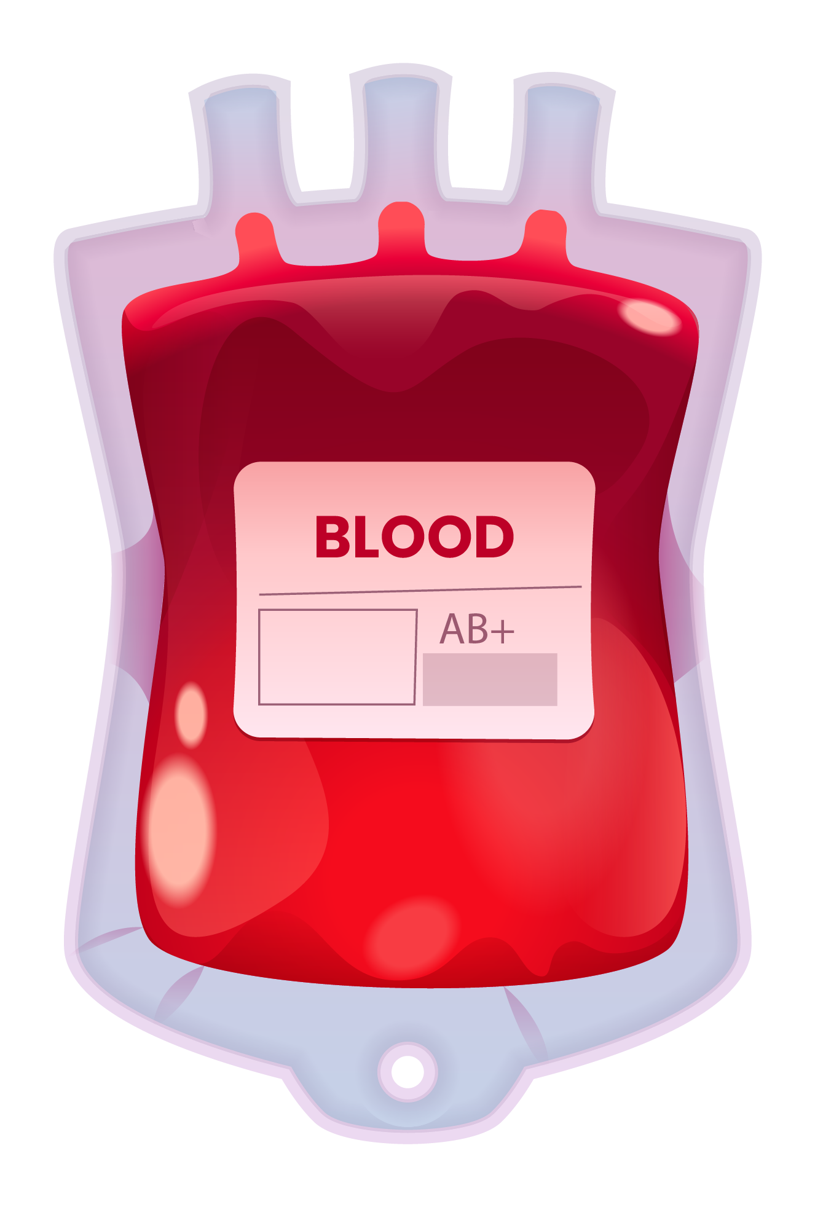
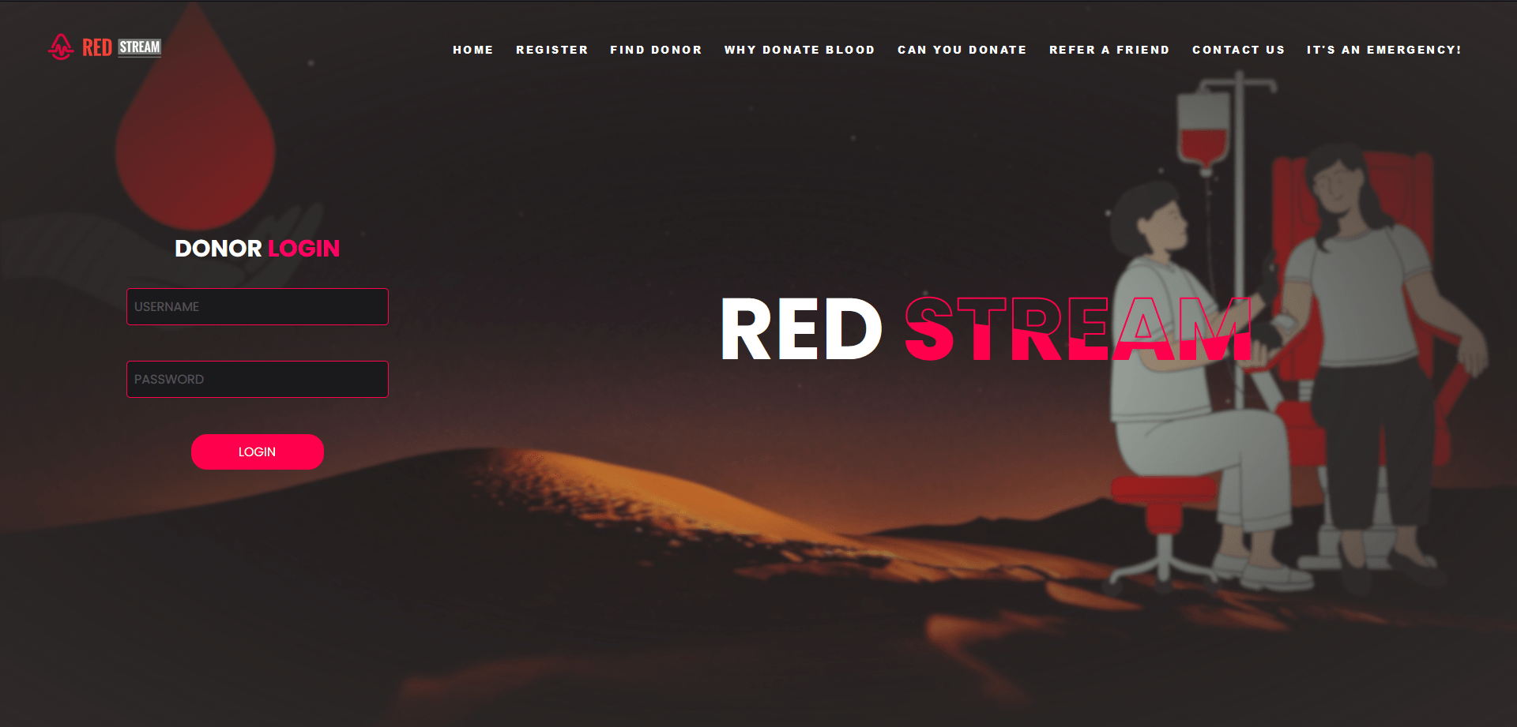
RED STREAM
CONNECT THE DONORS TOGETHER
GROUP MEMBERS
Arjun Mahesh
Sanju Sandeep
Sethu Satheesh
Sourav S
GUIDE :

Slide 2

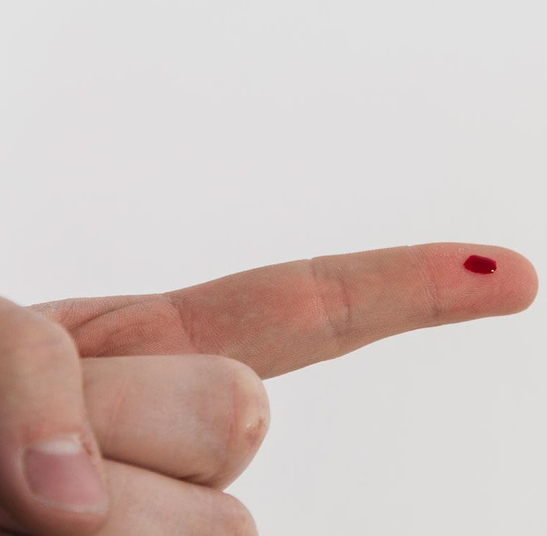

CONTENTS
● I NTRODUCTION
● O VERVIEW
● A DVANTAGES
● D ISADVANTAGES
● A PPLICATIONS
● C ONCLUSION
● R EFRENCE

Slide 3


INTRODUCTION
1
Welcome to Red Stream,the online blood donation platform that connect the donors together and making the process of blood donation simple by matching appropriate donors to the recipients.
1. WORKING
It works by finding blood donors and receivers by creating a central database of registered donors and allowing receivers to search for potential matches. Overall, the website aims to create a comprehensive and user-friendly platform that improves the process of blood donation and helps save lives by making it easier to find and connect with donors.
2. FLEXIBLE SERVICE
The website allows 24x7 service and support. Also recipients can pre-book or schedule the availability of getting blood for an upcoming day. This website also provides a facility of calling an ambulance provided by this institution itself in emergency situations.

Slide 4
3. DEDICATED MEMBERS
This is a donors community created by a group of dedicated polytechnic college students of Govt.Polytechnic college Kaduthuruthy, Govt.Polytechnic college Kottayam, Govt.Polytechnic college Pala. This is a non-profitable service doing by the student group aiming at the implementation of technology in social service. All the members in this group joined with their own decision and are willing to help others without any boundaries.
4. EFFICIENT
The website is more efficient in finding the appropriate blood donors to the recipients in an efficient way by matching the recipient and the donor details accordingly. Thereby using this site can save the time of the procedure and other complications usually occuring. This can also avoid some third-parties involved in the procedure and also saves money to an extend.

Slide 5






OVERVIEW
2
Red-Stream is an online blood donation website designed to have an efficient approach to the proccess of blood donation by matching the recipient data with available donor data and finding the appropriate donors.
The website front end will be built using:
HTML(Hypertext Markup Language) used for creating the main basic structure and content of webpages.
CSS (Cascading Style Sheets) - used for adding styles and layout to web pages.
JavaScript adds interactivity,animations, and dynamic functionality to web pages.
The back-end will be developed using :
PHP - a server-side scripting language widely used for web development

Slide 6
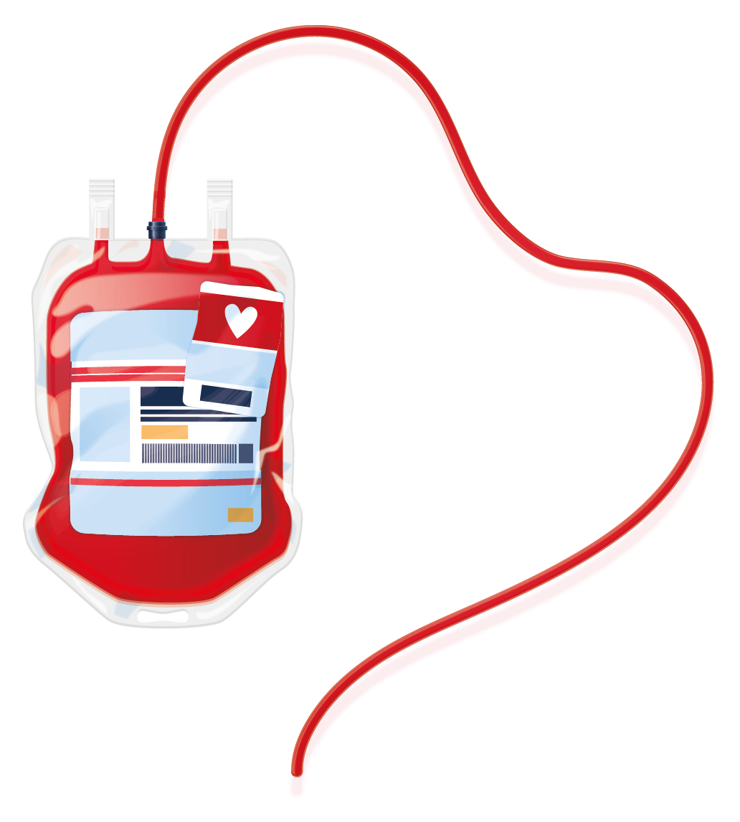
● A mysql database will be used to store the donor and recipient information securely.
● The backend with php works with the information given to the webpages and the information in the database to display or deliver the desired information efficiently.
● The website has a beautiful user-friendly interface makes any user to use the website very easily.
● The efficient profile matching methods and convenient scheduling options to receive the blood in a specific date and support for emergency situations make it an ideal platform for anyone looking for blood.
● There is an admin user to manage and update the website and it’s data and it’s informations at right time.

Slide 7
ADVANTAGES
3
1. Efficient and streamlined process: The website creates a central database of registered donors and allows receivers to search for potential matches, making the process of finding blood donors and receivers more efficient and streamlined.
2. Efficiency in making availability of blood: The website aims to increase the availability of blood by connecting donors and receivers in a more efficient manner, reducing the time and effort involved in the process.
3. 24x7 service and support: The website provides 24x7 service and support, which is
particularly useful in emergency situations.
4. Pre-booking and scheduling: The website allows recipients to pre-book or schedule the availability of getting blood for an upcoming day, providing more convenience and
Flexibility.
5. Dedicated team members: The website was created by a group of dedicated polytechnic college students who are committed to building a community of blood donors.

Slide 8
DISADVANTAGES
4
1. Limited coverage: The website may have limited coverage, as it is created and maintained by a small team of students from specific polytechnic colleges. It may not be accessible to everyone who needs it.
2. Dependence on donors: The website is dependent on the availability of blood donors, which may be unpredictable and vary depending on various factors such as location, time, and weather.
3. Privacy concerns: The website requires donors and recipients to register and share their personal information, which may raise privacy concerns among users.
4. Reliance on technology: The website relies on technology, such as the internet and database systems, which may fail or malfunction, leading to disruptions in the service.
5. Availability of blood: Here the blood is collecting only from the donors which are
registered to our community, there is no tie up with any other hospitals or blood banks. So the availability may vary depending up on the number of blood donors currently available.

Slide 9
APPLICATIONS
5
● Increased accessibility: Red Stream can provide easy access to the procedure of blood donation and find donors in just some clicks. Anyone can access the website from anywhere at anytime they desire.
● Improved convenience: Red Stream can provide convenience for individuals who may require blood in an upcoming day. Online booking can be scheduled to an upcoming day to receive the blood.
● Minimal effort: The recipients just want to submit the details that needed to match the donor, the procedures after that will be take care by our members. They are also willing to reach the spot around the coverage area specified by the recipients.
●Less expense: There is no cost in registering in the website and searching for donors or booking a donor, the service is totally free of cost as it is run by a group of students who have no aim in making profit.

Slide 10
● Support in emergencies : Red Stream offers some supports to the users in some emergency conditions like ambulance service and quick receiving of blood according to the donors we have.
● Knowledge to users : The website also contains some useful informations and recommendations who are coming to the website like precautions in blood donations, requirements, things to keep in mind etc. It helps users coming to the website to understand about blood donation and its procedures correctly.
● Reduce the rush: This service is helpful to an extend in order to reduce the rush generally occurring during the time of finding a donor normally, they runs here and there to find a donor and contacts everybody they have without any rest to get blood. This may can be reduced by this website as this acts as a centralized hub of many willing active donors with their contact.
● Save time: This service will also save a huge amount of time of every one finding a donor manually

Slide 11
CONCLUTION
6
In conclusion, the Red Stream website is a user-friendly and efficient platform that connects blood donors and recipients in an effort to streamline the process of blood donation. It offers a central database of registered donors and allows recipients to search for potential matches, thereby increasing the availability of blood in emergency situations. Additionally, the website allows for pre-booking and scheduling of blood donation appointments and provides 24x7 service and support. However, there are also some potential limitations to the website, such as limited coverage and dependence on the availability of blood donors. Overall, the Red Stream website is a commendable effort by a group of dedicated polytechnic college students to build a community of blood donors and recipients, and it has the potential to save lives by making the process of blood donation simpler and more accessible.

Slide 12
REFERENCES
7
Websites:
• World Health Organization (WHO)
(https://www.who.int/)
• National Blood Transfusion Council(NBTC)
(http://nbtc.naco.gov.in/)
• Red Cross Blood Donation
(https://redcrossblood.org/)
Books:
• The Gift Relationship: From Human Blood to Social Policy" by Richard M. Titmuss
• Blood Donation: Risks, Rewards, and Benefits" by Larry V. McIntire
Websites:
• World Health Organization (WHO)
(https://www.who.int/)
• National Blood Transfusion Council(NBTC)
(http://nbtc.naco.gov.in/)
• Red Cross Blood Donation
(https://redcrossblood.org/)
Books:
• The Gift Relationship: From Human Blood to Social Policy" by Richard M. Titmuss
• Blood Donation: Risks, Rewards, and Benefits" by Larry V. McIntire
Websites:
• World Health Organization (WHO)
(https://www.who.int/)
• National Blood Transfusion Council(NBTC)
(http://nbtc.naco.gov.in/)
• Red Cross Blood Donation
(https://redcrossblood.org/)
Books:
• The Gift Relationship: From Human Blood to Social Policy" by Richard M. Titmuss
• Blood Donation: Risks, Rewards, and Benefits" by Larry V. McIntire

Slide 13

THANK YOU!

